Slide 1
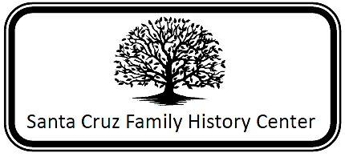
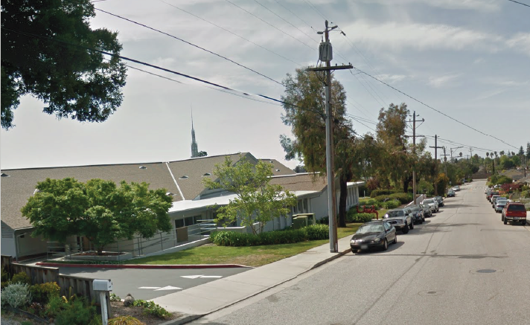
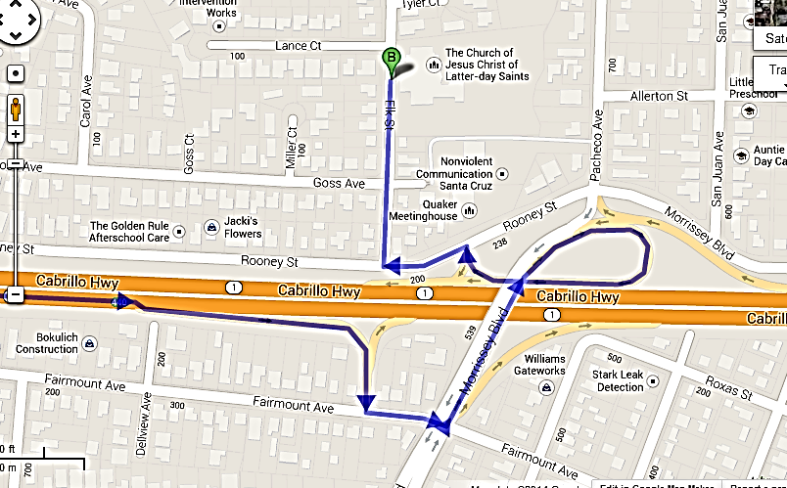
220 Elk Street
(831) 426-1078
Hours: Tuesday 9:00am-3:00pm; Wednesday 9:00am-9:00pm,
Saturday 9:00am-noon
Directors: Ruth Cameron and Debbie Simms
Directions from Highway 1 coming from Santa Cruz:
Take the Morrissey Exit
Turn left onto Morrissey
Cross Highway 1
Continue on Morrissey
Left toward Rooney
Left onto Rooney
Right onto Elk Street
Destination on right.

Slide 2
Premium Web Sites
(free at Family History Center)
19th Century British Library Newspaper Digital Archives
Access Newspaper Archive
Alexander Street Press – American Civil War
Ancestry.com
ArkivDigital Online – Swedish Church Records
Find My Past – UK
Fold 3.com
The Genealogist
Godfrey Memorial Library
Heritage Quest Online
Historic Map Works Library Edition
Legacy Stories (New from FamilySearch)
Paper Trail
World Vital Records
Local Collections
Early Land Records (1833-1845)
  Spanish and Mexican Grants (including Tract Books) – California Counties (in Spanish)
    San Benito
    Santa Clara
    Santa Cruz
      Mission Church Records
    Monterey
      Mission Church Records
    Alameda
    Los Angeles

